Slide 1
Savitribai phule pune university
Sinhgad technical education society’s institute of business administration and research kondhwa.
Course Name: Project Presentation
Project Name: Online Furniture Shop
Student Name : Kundan Pise
Roll Number : 49 Semester : IV
Seat No. 21474

Slide 2
Introduction
It is an online furniture shop that allows users to check for various furniture available at the online store and purchase online. The project consists of list of furniture products displayed in various models and designs. The user may browse through these products as per categories. If the user likes a product he may add it to his shopping cart. Once user wishes to checkout he must register on the site first. He/she can then login using same id password next time. User can select any payment option that he wish to like credit card, debit card or cash on delivery. Once the user makes successful transaction he gets a copy of the shopping receipt on his email id. Here we use. The online furniture shopping project brings an entire furniture shop online and makes it easy for both buyer and seller to make furniture deals.

Slide 3
sCOPE OF THE PROJECT
This system can be implemented to any shop in the locality or to multinational branded shops having retail outlet chains. The system recommends a facility to accept the orders 24*7 and a home delivery system which can make customers happy. Customers can also manage their shopping cart by adding and removing the items. If shops are providing an online portal where their customers can enjoy easy shopping from anywhere, the shops won’t be losing any more customers to the trending online shops such as flipcart or ebay. Since the application is available in the smartphone it is easily accessible and always available..

Slide 4
PROPOSED SYSTEM
“Online furniture shop” is a web based application. The main aim of this project is to established on online furniture shop system which allows the user to buy the furniture online. User can make online payment through credit card and debit card. But this present generation which has money but lack of time can’t go to the furniture shop to buy furniture. It is tedious and time consuming process.
By keeping these point in mind we have develop this online furniture portal. This project will be very much helpful for the present generation which runs shortage of time . customer to browse through the shop and purchase them online without having to visit the shop physically. Now they can obtain their desire furniture without leaving the comfort of their home. They can also place the order of their desire design making their life more comfortable and luxurious.

Slide 5
Objective
This proposed system is computerized system and it improves the performance of the system.
The system is developed in manner that it is user friendly and required validation are provided at different level.
It helps customer to find different type of furniture.
The system is easy to handle.
To facility easy retrieval of data & information.
Data should be remaining secured even on system crash.
To enhance speed of work.

Slide 6
SYSTEM REQUIREMENTS
A ] hardware requirements:
Processor:- intel pentium 4 or above
Memory:- 2GB or above
Hard disk:- (minimum) 40GB
B] software requirements :
Technology used:- HTML,CSS,JS,BOOTSTRAP
Database server:- PHP,MY-SQL
Operating system:- windows 10
Browser/framework:- google chrome

Slide 7
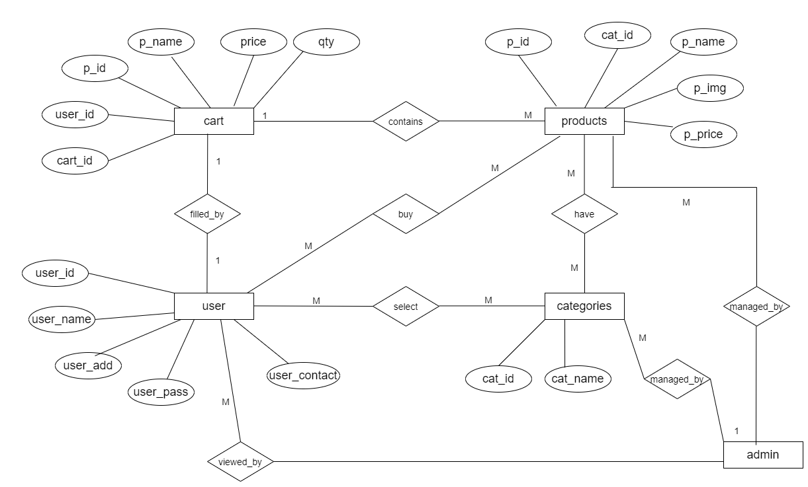
eR Diagram

Slide 8
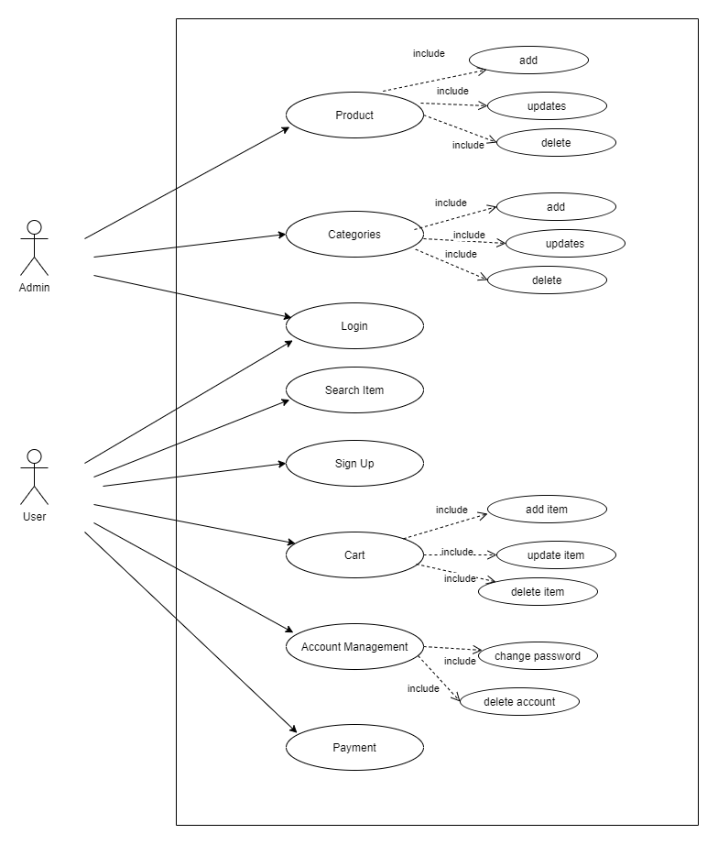
USE CASE DIAGRAM

Slide 9
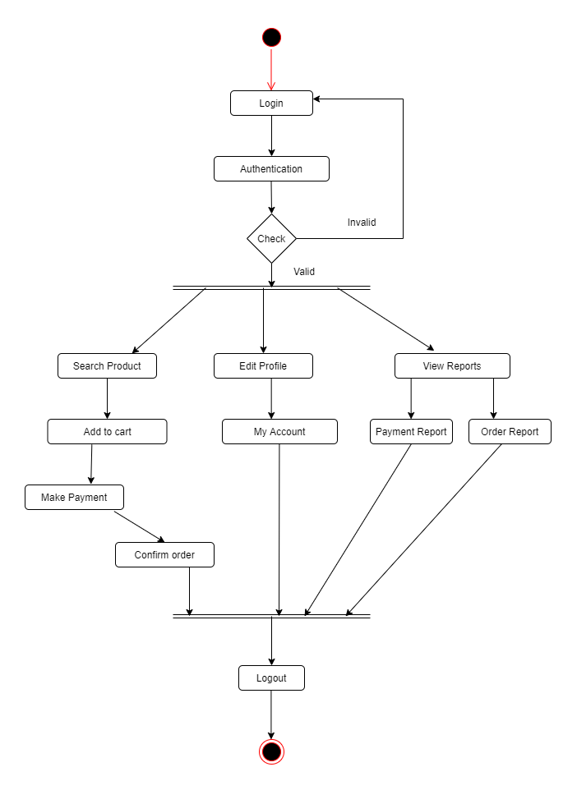
ACTIVITY DIAGRAM

Slide 10
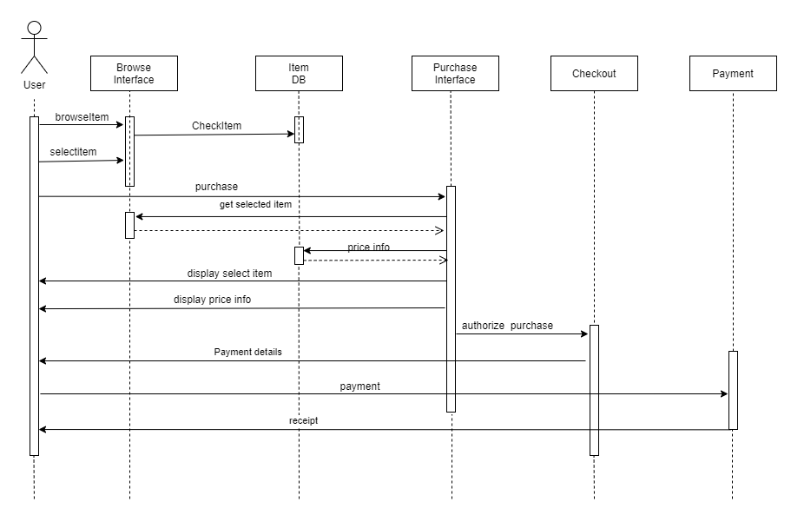
SEQUENCE DIAGRAM

Slide 11
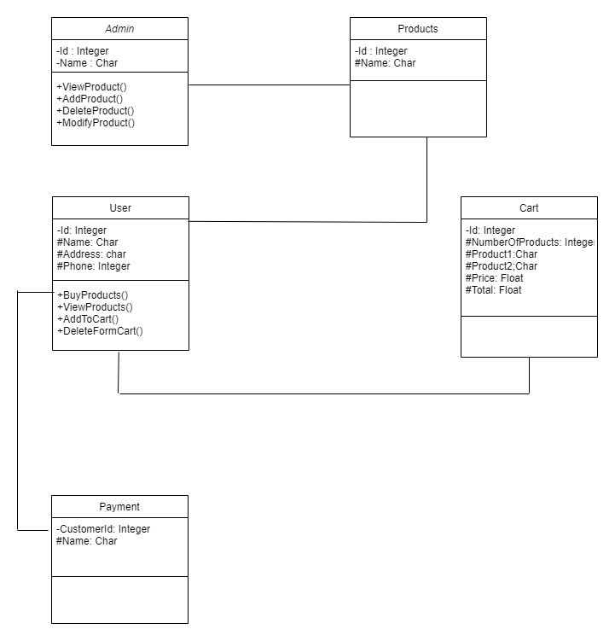
Class Diagram

Slide 12
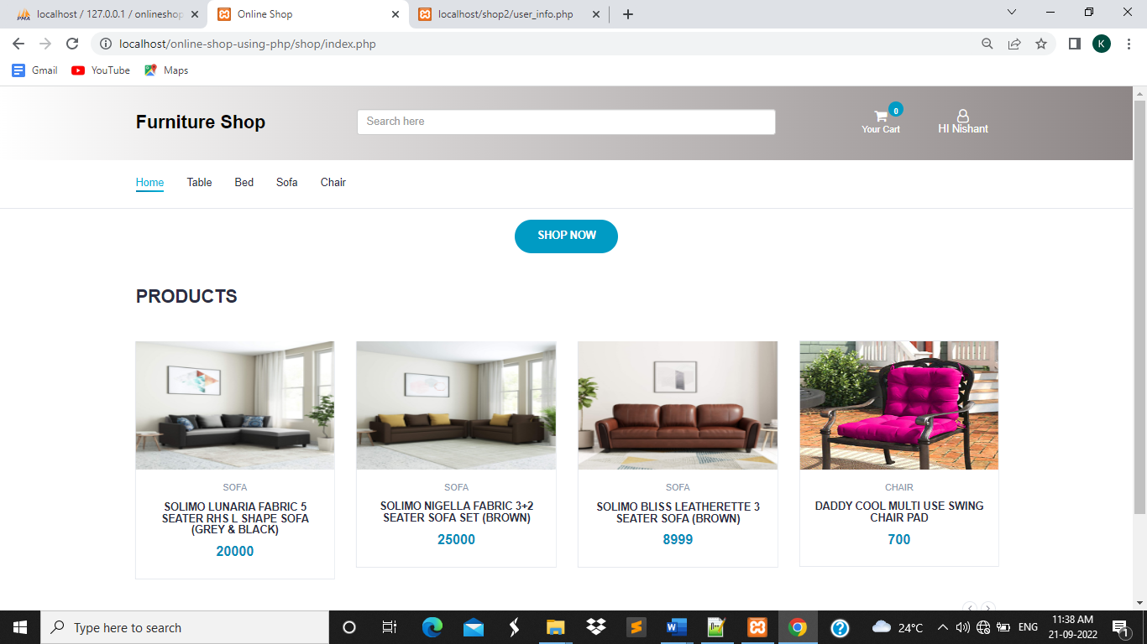
Home Screen

Slide 13
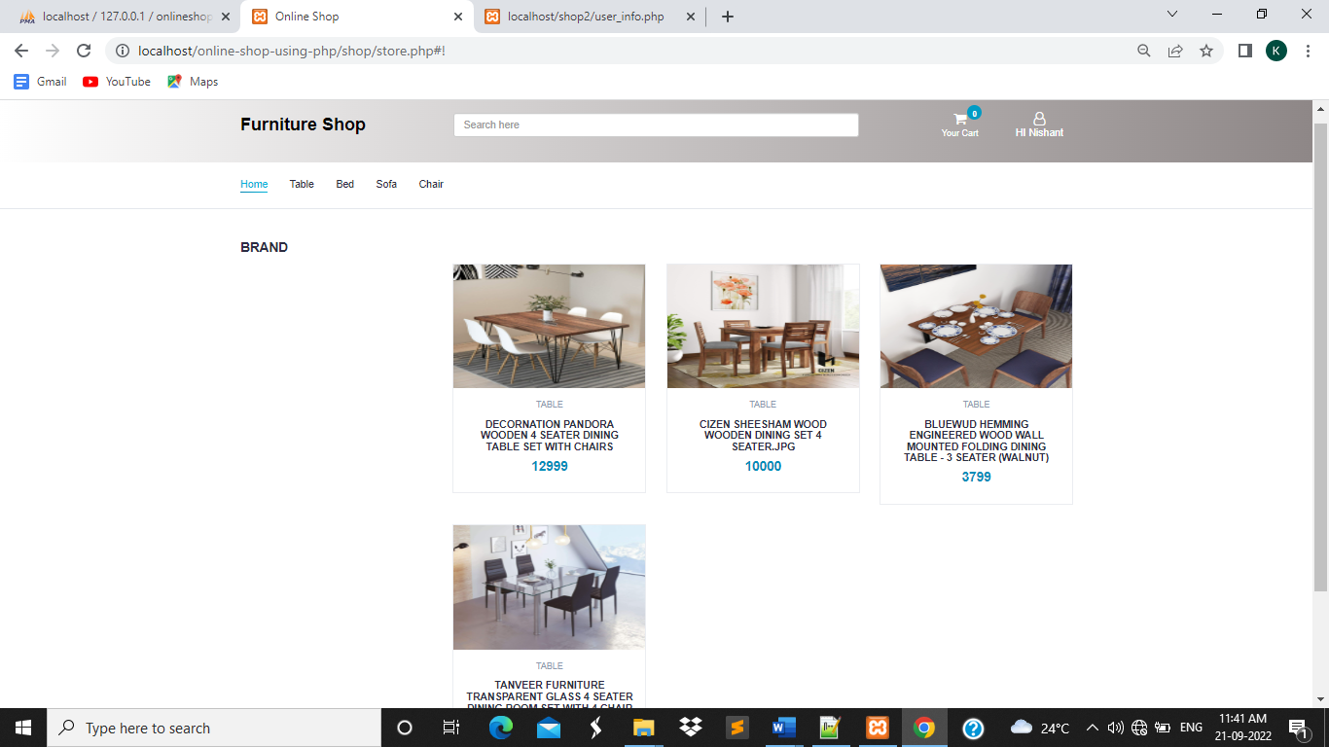
PRODUCT Screen

Slide 14
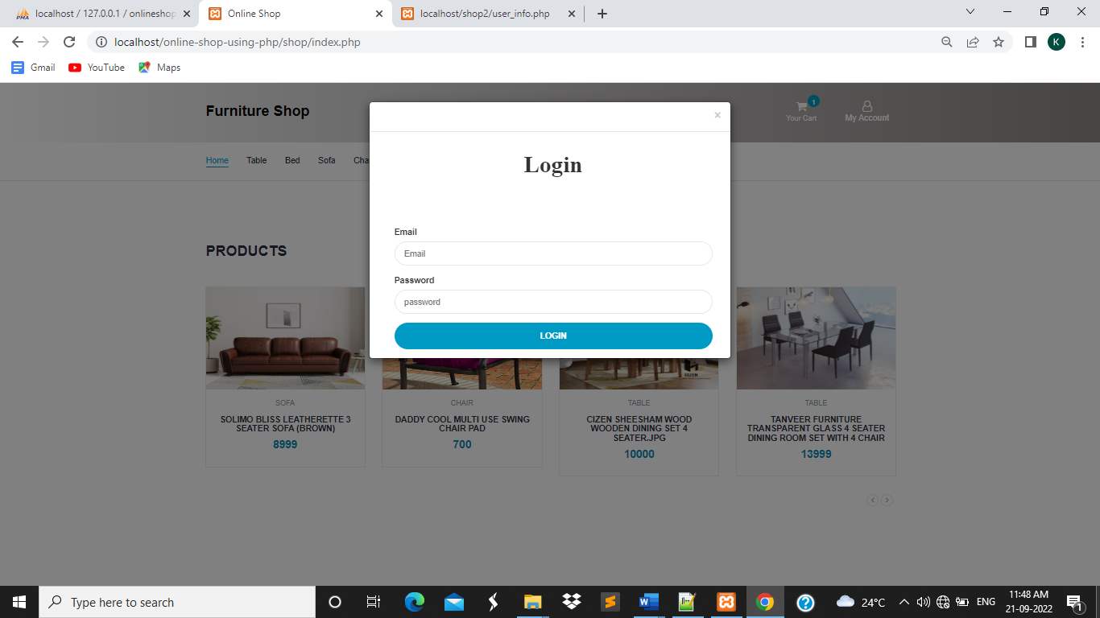
LOGIN Screen

Slide 15
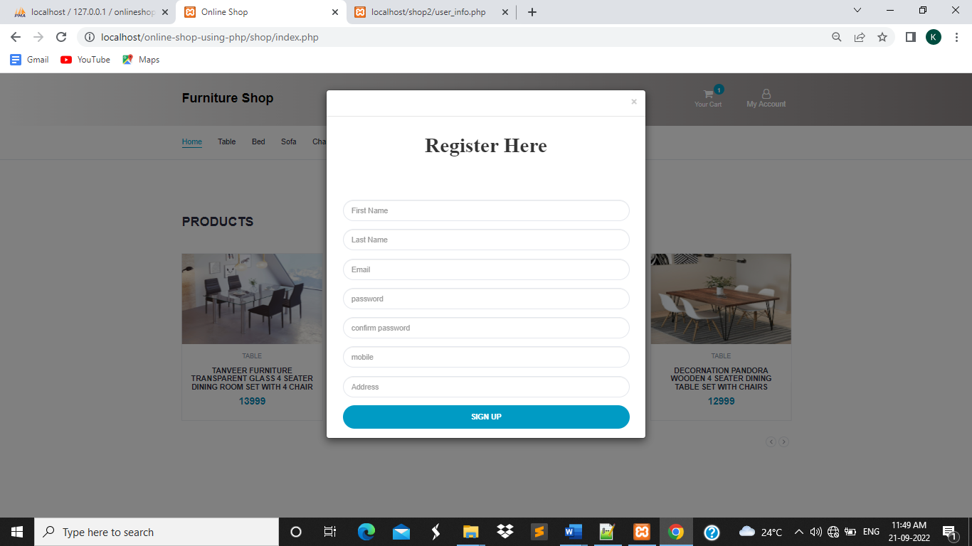
REGISTER Screen

Slide 16
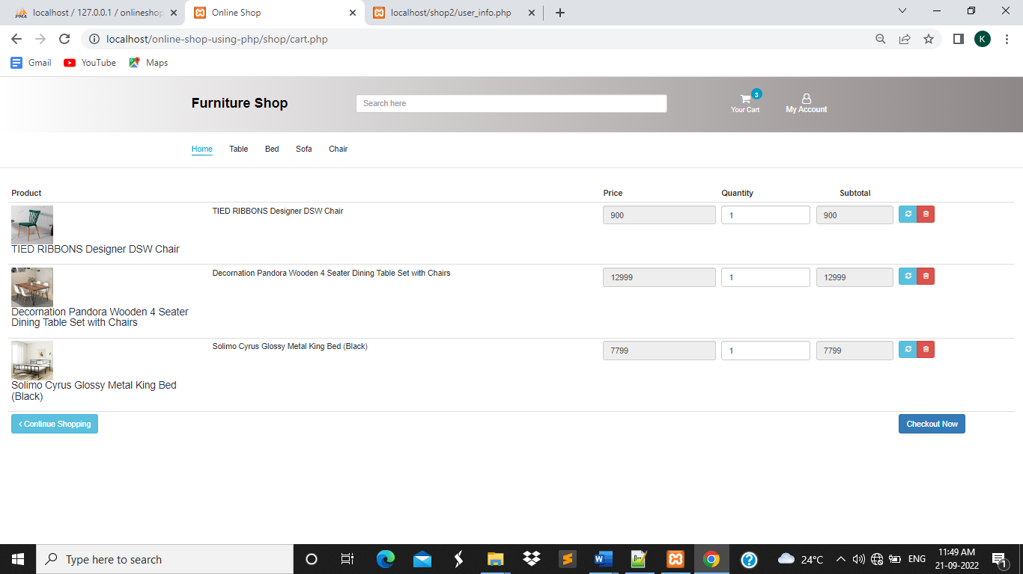
CART Screen

Slide 17
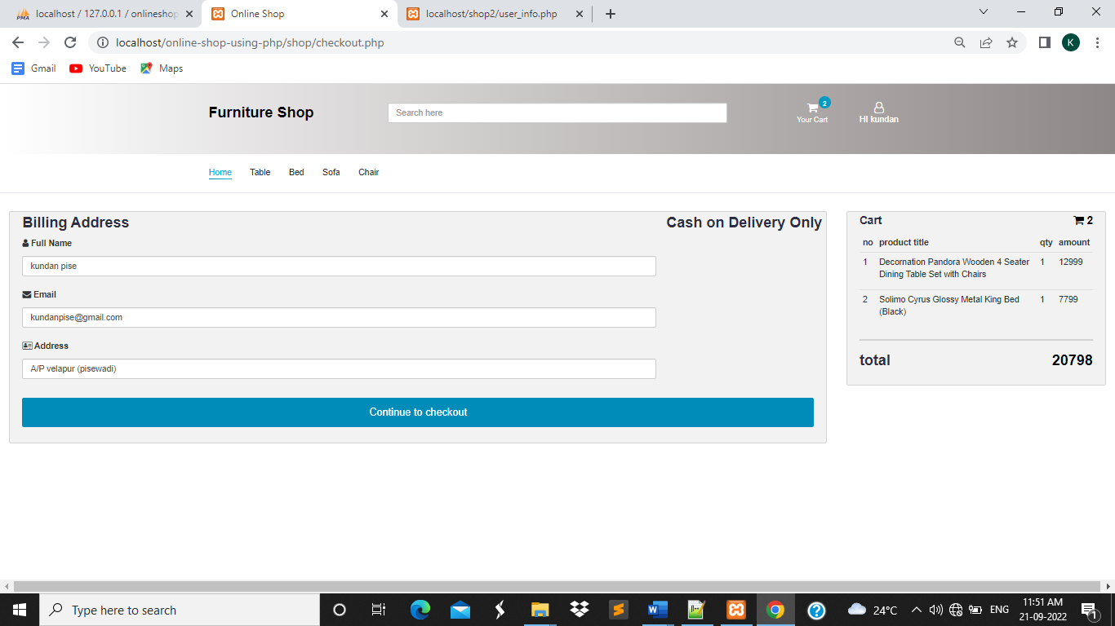
PAYMENT Screen

Slide 18
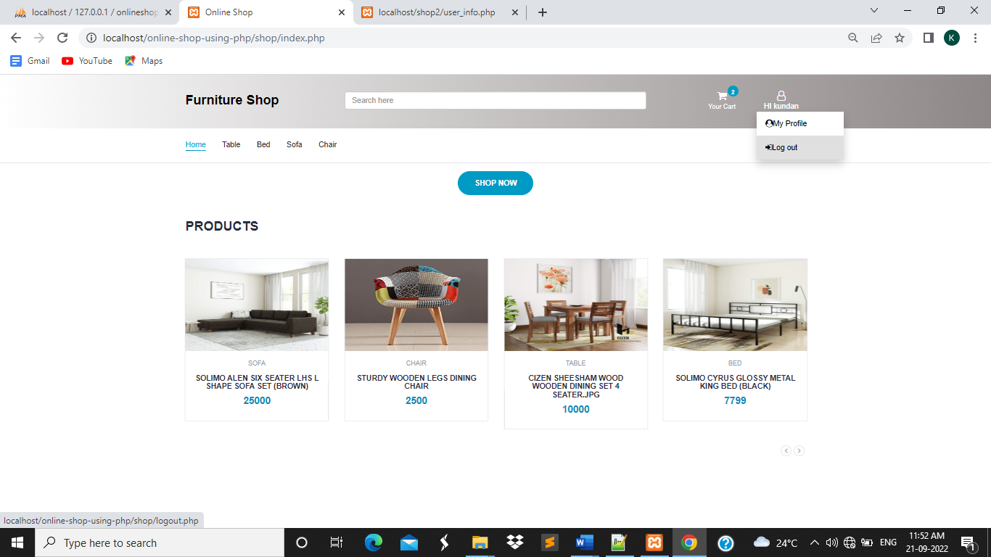
LOGOUT Screen

Slide 19
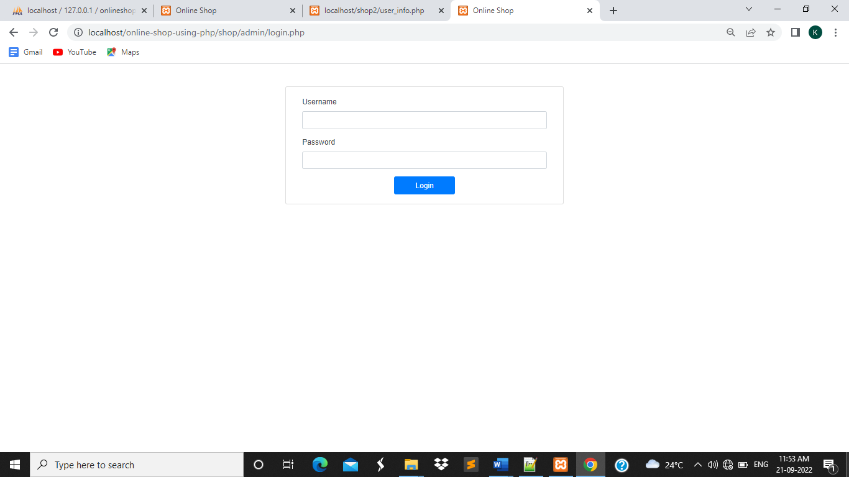
ADMIN LOGIN Screen

Slide 20
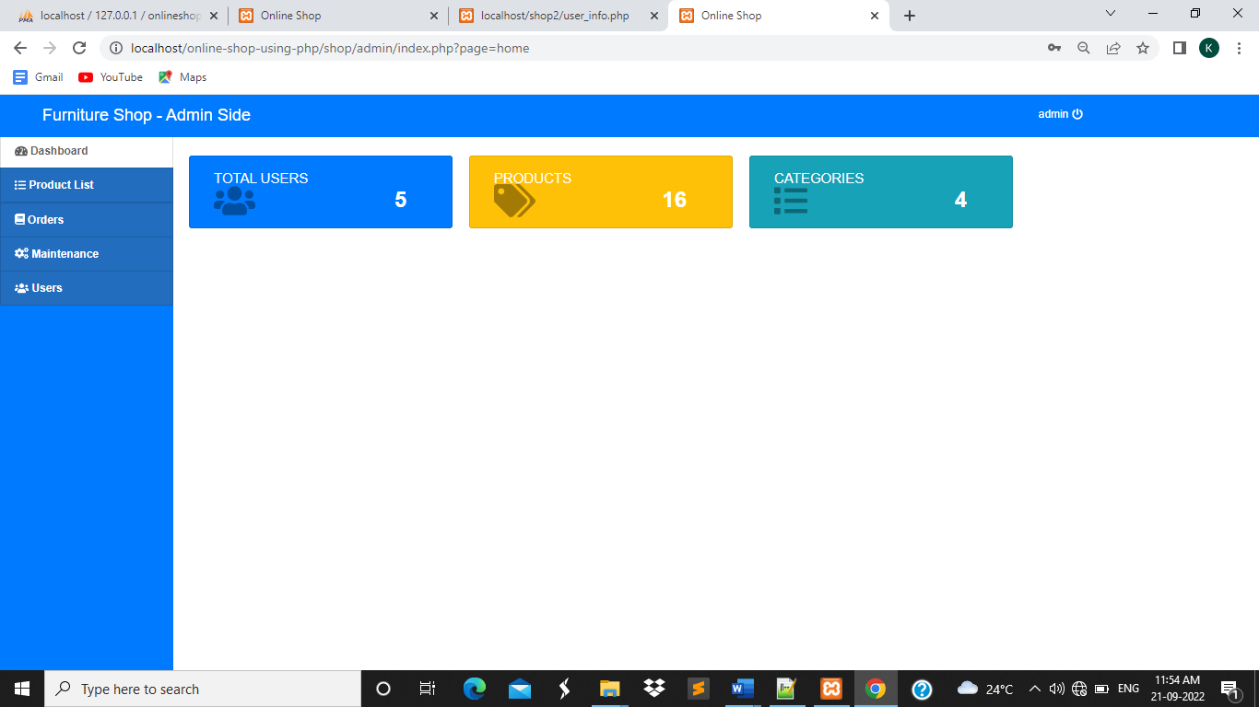
ADMIN LOGIN Screen

Slide 21
ADD PRODUCT Screen

Slide 22
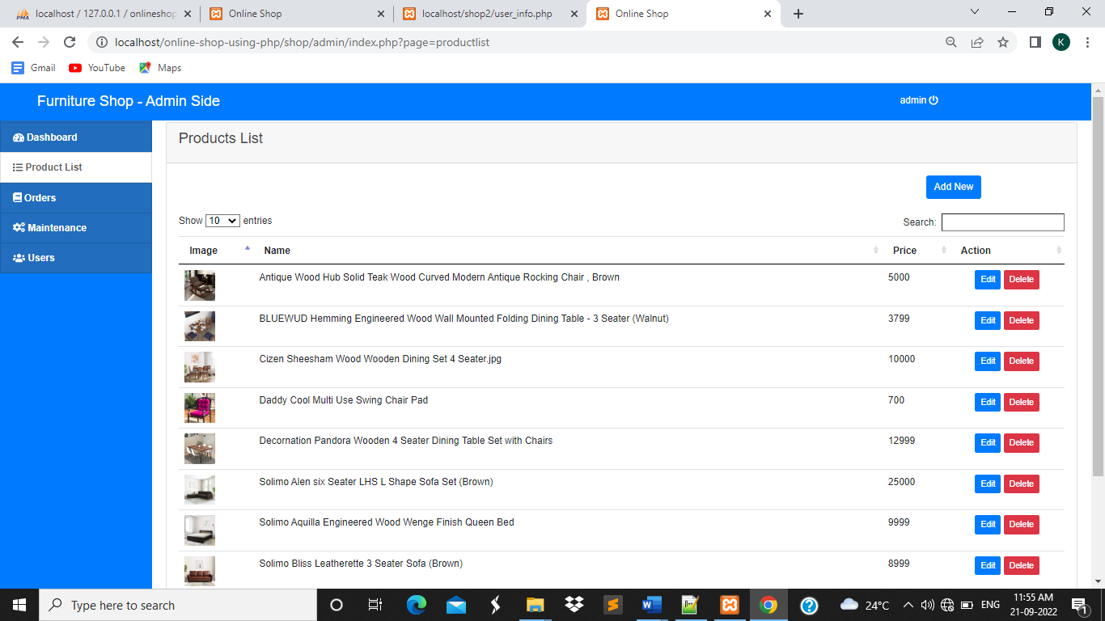
PRODUCT LIST Screen

Slide 23
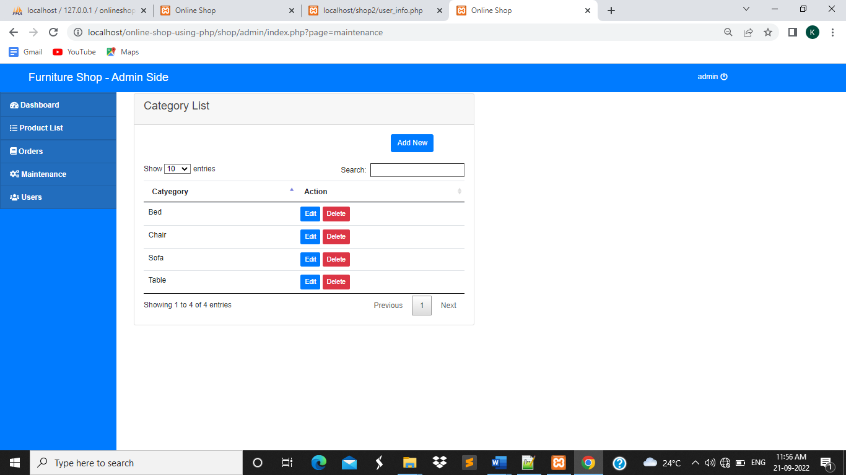
ADD CATEGORY Screen

Slide 24
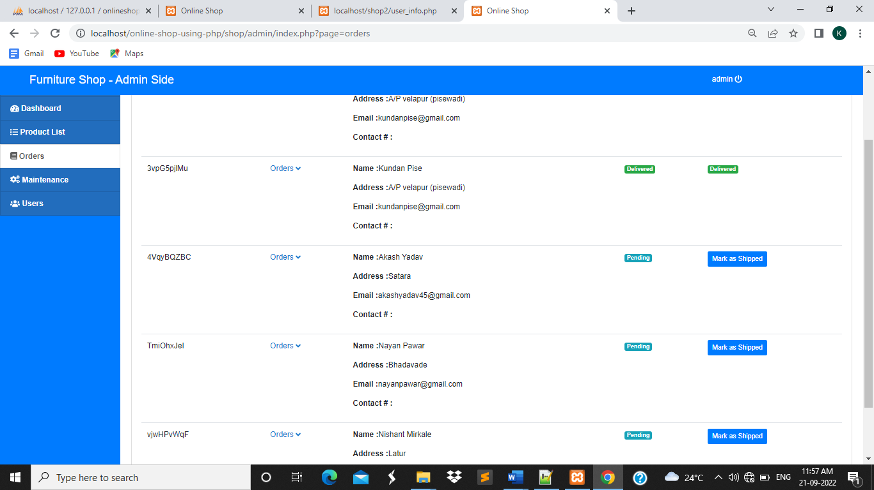
ORDER Screen

Slide 25
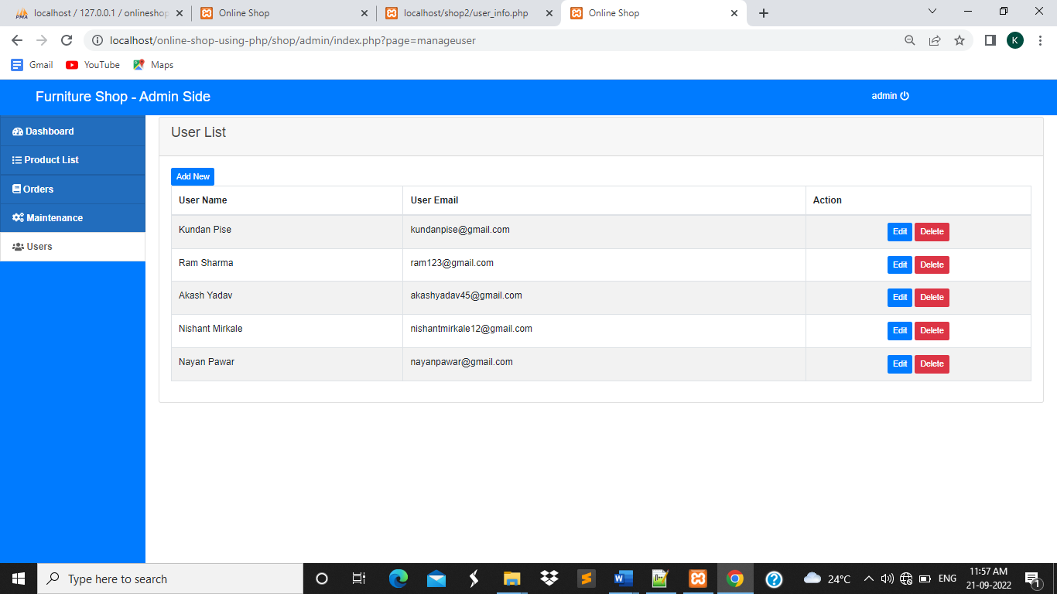
USER INFO Screen

Slide 26
Thank YOU

